Slide 1

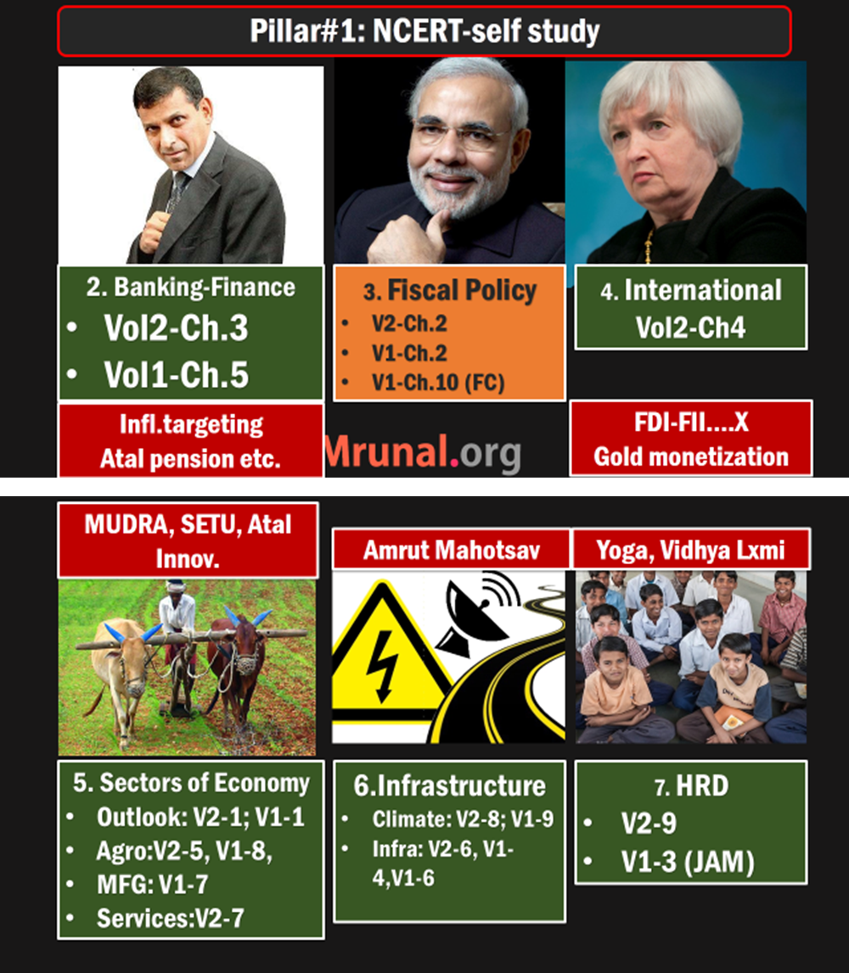
Env. Vs Economy
1st world vs 3rd World
Climate Finance
Environment clearance
Last Time
Rio Evolution
Intl. Finance
Natl. Finance
Kyoto to Paris
India’s Stand

Slide 2
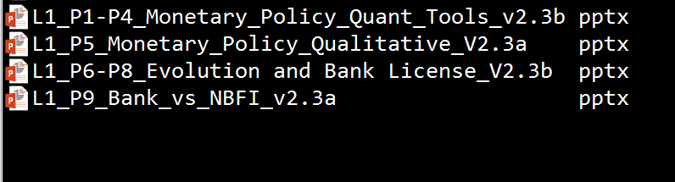

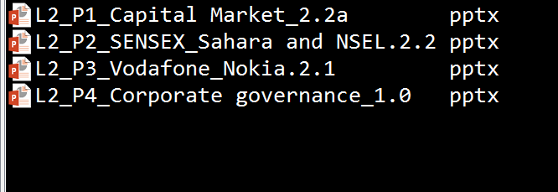
L2/P5 and P6= Insurance
L2/P7…Bank-Finance- reforms, BASEL, 2x financial repression

Slide 3
SS, NPS, Atal Pension
Insurance: Theory & Types
Insurance: History & Nationalization
IRDA, Powers
Public sector insurance Co.
Fin. Inclusion:
PM JJ & Surksha
Intermediaries & Ombudsman
49% FDI: Pro-Cons

Slide 4
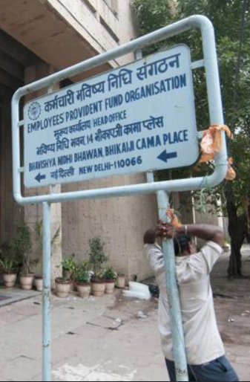
ESIC, EPFO
NPS & Atal Pension
Social Security-सामाजिक सुरक्षा Meaning & History

Slide 5
India 2015 Yearbook
Chapter 8: Comm. & IT Page 183: Postal life insurance
Chapter 13: Finance page 353: pension / insurance sector. But not much content
Chapter 21: Labour and employment - Page 620 onwards: Social security laws

Slide 6
SS =Protecting worker & his family, against health related eventualities.
Health / work related eventualities
Why SS?
Treatment
Compensation
If no SS?
Child labour
Death
Maternity
Sickness
Rehabilitation
Prostitution
Destitution
Human dignity
Crime
Disability
Unemployment

Slide 7

Sir William Beveridge (1879-1963)
SS
Born in Bengal, economist
1942: report- social insurance
1945: PM Clement Attlee (Labour) replaced PM Winston Churchill (Conservative)
Attlee promised to implement Beveridge report- Social security from cradle to grave; Free medical treatment to all.

Slide 8

British India to Free India
SS
Prof.B.P.Adarkar -> 1st Social security scheme in 1944
Sardar nicknamed him “Chhota Beveridge”
Employees' State Insurance Act’48
ESIC = “Corporation”, not Company
24th Feb. 1952: Employee state insurance scheme, Nehru 1st to join

Slide 9
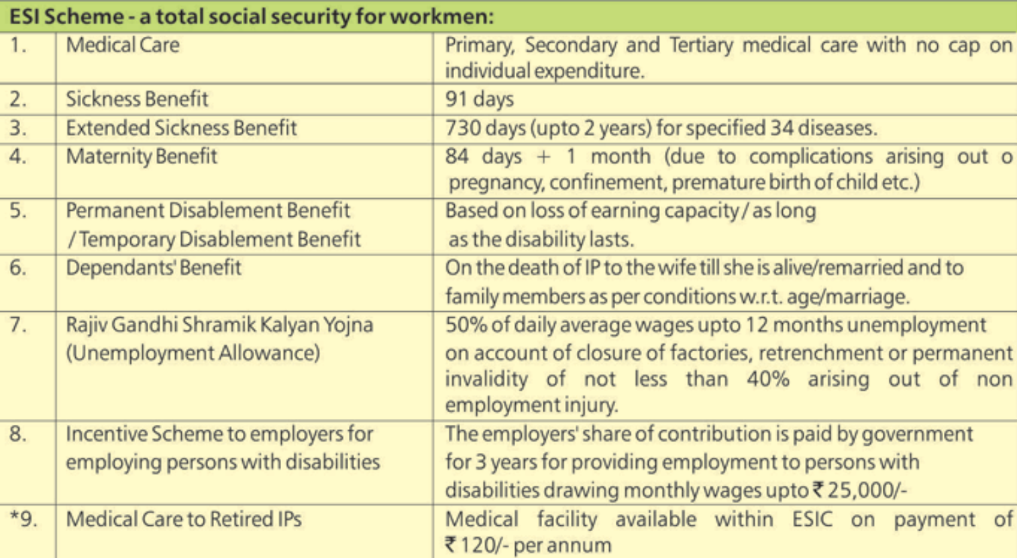
ESI scheme: benefits? For more this link

Slide 10
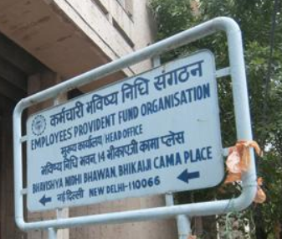
EPFO
SS-Pension
Employees Provident fund
‘51: Ordinance
‘52: Act, except J&K.
Under administrative control of Ministry of Labour and Employment
3 party board
3 schemes

Slide 11
Tri-partite “Central Board of Trustees”
Government (union + state): 15 reps
Employers (Boss): 10
Employees (worker): 10
Board

Slide 12
EPFO: 3 schemes
Provident Fund’55
Pension’95
Deposit Linked Insurance’76

Slide 13
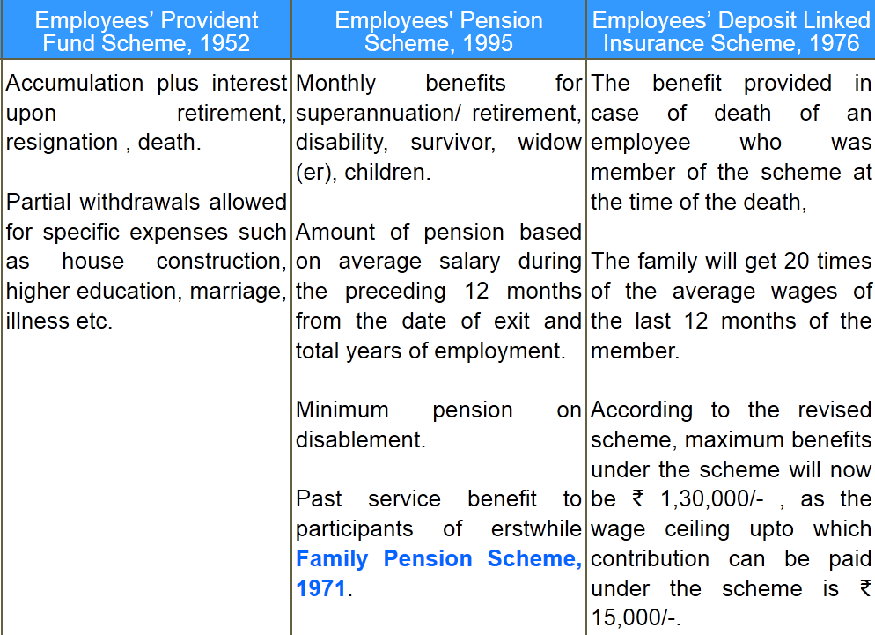
EPFO: three schemes, further details link

Slide 14
EPFO usually in news for….
Survey: use this to finance long term infra. Projects esp. NHAI
Employer (LIN)
Employee (UAN)
Contribution
Trustee board decides investment pattern
Annual return: 8.75%
Labour identification #
Shram-Suvidha portal
Inspection, grievances redressal
Mandatory if salary<15k
12% basic salary
Equal match by employer
Modi: min.1k pension
5% corpus in ETF=higher return, disinvestment help
EPF- Appellate tribunal officials not appointed for a long time
Universal Account Number
Portability when changing jobs
Notes:
Every month, 12 per cent of your basic salary goes into the provident fund account and the employer matches the contribution. Out of the employer's contribution, 8.33 per cent goes into the Employees Pension Scheme, which offers pension from the age of 58.
Universal Account Number (UAN)
1) EPF is now mandatory to all those whose salary is less than Rs.15,000
Previously the limit was Rs.6,500. But this is now raised to Rs.15,000. So whoever falls below Rs.15,000 of salary per month then they will have to contribute compulsorily to EPF Scheme.
Besides this, the government will launch unified web portal LIN (Labour Identification Number) for simplifying business regulations and bring in transparency and accountability in labour inspections by various agencies and bodies under the administrative control of labour ministry. This Web portal will provide for filing of single harmonized annual returns by the employers.
The employers will be allotted LIN after registration on web portal. The enforcement agency will upload the data of inspection on the Web portal which will be updated periodically. This portal would provide online reporting of harmonized inspection report by labour inspectors and inspecting officers of other bodies such as EPFO administered by labour ministry. PTI

Slide 15
PFRDA: New Pension Scheme (NPS) 18-60 yrs
1/1/04: Central govt new recruits except armed forces
Employer
Employee/ self employed
Subscription
2013: PFRDA Act (WEF ‘14)
NPS- fund managers (HDFC, SBI, LIC etc.)
Return based risk-selection.
Asset-E – Equities
Asset-C – fixed income debts except G-Sec
Asset-G: only G-sec.
Govt. co-contributes for only for selected categories
Government employee (10% Basic+DA)
Unorganized worker outside other schemes
NPS-Corporate model: equal/unequal co-contribution by boss
All states expect 2
2009: Indian ‘citizens’, voluntary
2010: Swavlamban- unorganized co-contributory if not covered elsewhere
No EEE status, hence not many takers
PRAN: Permanent Retirement Account Number
Tier-1 account- can’t withdraw before retirement, tax benefit- yes
Tier-2 “Savings” type account, withdraw with caveats- no tax benefit
Notes:
Universal Account Number (UAN)
Besides this, the government will launch unified web portal LIN (Labour Identification Number) for simplifying business regulations and bring in transparency and accountability in labour inspections by various agencies and bodies under the administrative control of labour ministry. This Web portal will provide for filing of single harmonized annual returns by the employers.
The employers will be allotted LIN after registration on web portal. The enforcement agency will upload the data of inspection on the Web portal which will be updated periodically. This portal would provide online reporting of harmonized inspection report by labour inspectors and inspecting officers of other bodies such as EPFO administered by labour ministry. PTI

Slide 16
EPF/ PPF: no income tax @3 stages (EEE)
$ Deposited
$ Interest Earned
$ Redeem @Maturity
EPF/PPF has “Exempt-Exempt-Exempt”
NPS have this “Exempt-Exempt-Taxable”.
~80 lakh subscribers but difficult to get more due to this.
Notes:
At present, IT act Sec 80C now allows tax reliefs for upto Rs.1.50 lakh invested in PPF, NPS, Insurance etc. Rajanbhai says this limit should be increased further. In recent years, National savings rate reduced from >35% to ~30% of GDP. IF tax relief increased, juntaa will save more money and through financial intermediaries it can become credit/capital for faster growth of Indian economy.

Slide 17
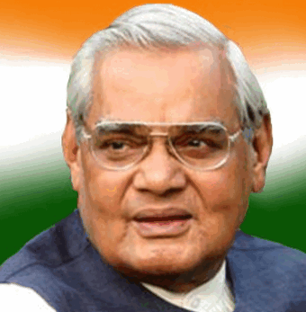
Atal Pension Yojana
Pension
Budget 2015 announced
Eligibility: 18 to 40 years
Unorganized workers to get pension after 60 years age.
Can’t exit before 60 age
Pension of Rs.1k, 2k, 3k, 4k and 5k per month, depending on contribution by the client.
PFRDA to implement, money auto debited from your bank account

Slide 18
Atal Pension Yojana
Pension
Government to contribute equal amount in the fund, for five years
if you're not an income tax payer, and not covered in any other social security scheme of Government such as EPFO, Coal Mines, Tea plantation, Seamen's provident fund, J&K employee PF etc.

Slide 19
Atal Pension Yojana
Pension
Previous Swavlamban scheme had similar feature- Government to co-contribute in unorganized sector worker's NPS account.
Now all those Swavlamban accounts to be migrated to Atal Pension Yojana, unless the client wants to opt out. Then he'll continue in NPS.

Slide 20
ESIC, EPFO
NPS & Atal Pension
Social Security Meaning & History

Slide 21
SS, NPS, Atal Pension
Insurance: Theory & Types
Insurance: History & Nationalization
IRDA, Powers
Public sector insurance Co.
Fin. Inclusion:
PM JJ & Surksha
Intermediaries & Ombudsman
49% FDI: Pro-Cons

Slide 22
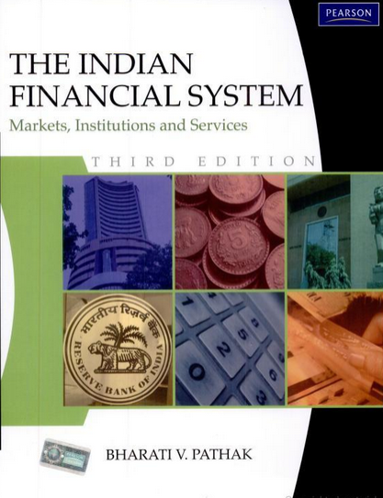
Insurance theory & Types
What?
How different than bank/MF
Why imp. For Economy
Principles
Types
If any discrepancy in these PPTs vs. wiki,Ramesh, Dutt-Sundaram et al that’s bcoz I refer to book for Banking, Finance and insurance topics. PS: You don’t need to buy or read this book.
This is only for ‘disclaimer’.

Slide 23
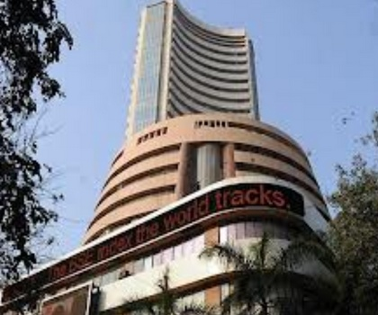

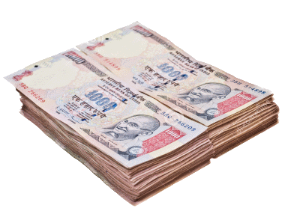

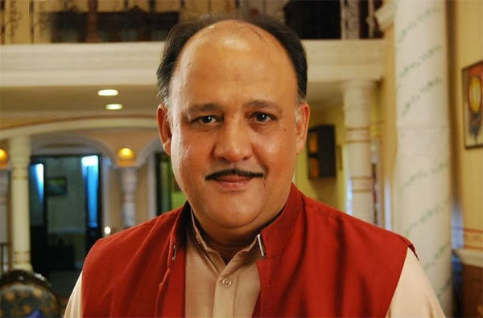
Social device / legal contract
Against eventualities of death / damage
Life insurance
Non-Life insurance
Premium
Insurer
Assurer
Underwriter
Insured
Assured
Client
Notes:
What is insurance?

Slide 24

Different than other FI –MF, Banks
insurance
Insurance policy: debt instrument
Insurance Co = Liability driven financial intermediary.
Risk capital / solvency capital norms are high. (Banks- SLR, CRR)
Banker, MF Manager- Rates easy to decide:- op.cost, return, commission.
Policy premium: statistics, probability theory, demographic trend, return in financial market.

Slide 25
Different than other FI –MF, Banks
insurance
Insurance is “SOLD”, never “Bought”.
Broker, agents needs more marketing skills & client network, than an Banker / MF manager

Slide 26
Insurance theory
What?
How different than bank/MF
Why imp. For Economy
Principles

Slide 27
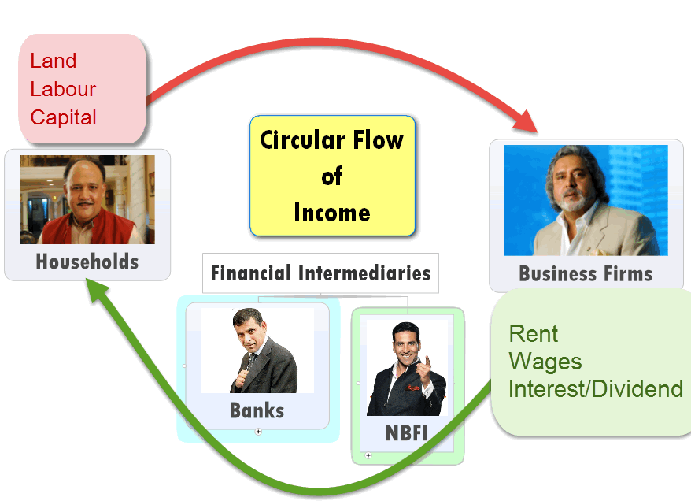
Why important for economy?
insurance
Stability in household against death / disability /damage– else child labour & prostitution
▼ burden on Government to run social security schemes: ▼ fiscal deficit

Slide 28
Why important for economy?
insurance
Entrepreneur can’t take bold decisions without insurance of property, transport etc.
Insurance as an “FI”: turns savings into investment – circular flow of money.
Has to invest part of premium in social / economy infrastructure

Slide 29
Insurance theory
What?
How different than bank/MF
Why imp. For Economy
Principles

Slide 30
Principles of insurance (not much for UPSC)
Indemnity
Only to extend of “REAL” loss, not imaginary
Subrogation
Insurer can Recover from negligent 3rd party
Causa proxima
Direct loss link (explosion w/o fire= no $$)
Uberrima fides
Good faith, hide nothing
Insurable interest
If “x” not happen, client remains in same position, “x” happens client in bad position
Notes:
Uberrima fides: utmost good faith- if client gives wrong info=> company not liable to pay
Indemnity: client can’t make “profit” on his loss.
Subrogation: IF negligent third party responsible for loss. Client can’t claim from him. Insurance co. pays clients then recovers $$ from negligent third party.
Causa proxima: loss cause has to be direct and insured one.
Insurable interest: e.g. husband on wife’s life; merchant on his cargo. otherwise “wagering / betting /gambling” contract if direct interest is absent.

Slide 31
Insurance: Types and problems
Life (~80%)
Non-Life (~20%)
Max- 3rd party motor

Slide 32
Life insurance (80C income tax benefit)
Endowment
Money @maturity
Money @death
Whole life
Money @Maturity…no
Money @death…Yes
Term insurance
Only if you die within term
Else no return. But premium cheap
Unit linked insurance policy (ULIP)
Premium $$ invested in a fund
Return linked to performance of fund (like MF)
Debt fund, balanced fund, equity fund
Must show NAV on daily basis
Notes:
List is not exhaustive

Slide 33
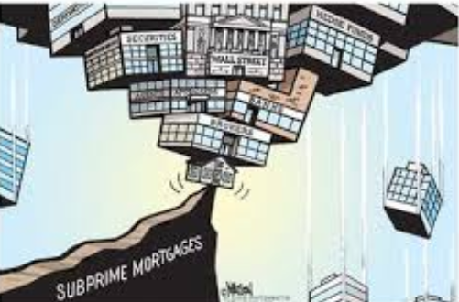
Issues
Life insurance
Top players: LIC, ICICI Prudential, SBI life
ULIPs lost shine after subprime crisis hurt Indian share market
Inflation – negative REAL interest
Consumers Shifting from insurance to “pension” for better returns while being “ALIVE”
Cost of ops. High, need more working capital : FDI 49%

Slide 34

Issues
Life insurance
Agents focus on “selling” from tax-benefit / “rate of return”
rather than generating awareness abt need for insurance
=> other pension / investment products with better returns & tax benefits
=> rural penetration low, because they’re not income tax payers, & see +ve real return in gold

Slide 35


What’s new?
amendment
Life insurance policy can be used as collateral for loan- unless insurance company disagrees.
Will help the farmers / families to borrow
Notes:
Technical provisions: beneficiary nominee and collector nominee…..X

Slide 36
Insurance: Types and problems
Life (~80%)
Non-Life (~20%)
Max- 3rd party motor
Some Types
Problems

Slide 37
General insurance Types
Fire
Comprehensive: both owner & others
Motor (largest biz)
industrial assets
Health insurance
Cashless
reimbursement
Amendment: obligatory for companies to underwrite 3rd party insurance
3rd party: insures party other than owner – Compulsory under law
houses

Slide 38
General insurance Types
Marine
Rural
Cargo
Hull / vessel
Crops
livestock

Slide 39
General insurance industry problems
House fire / theft
Motor vehicle
Fear of discovery of ‘value’
IT raids & ransom demands
Only 3rd party because compulsory.
Not doing “comprehensive”
MSME industries: transit / operation
“Value” for money , tailormade products….x
Adverse selection
Risky persons buying- e.g. high BP, Obese, diabetic person
Moral hazard
Insured vehicle- careless to lock it

Slide 40

Health insurance (general)
insurance
Insurance: highly regulated
Healthcare: highly ‘unregulated
Supply demand mismatch: between (doctors-hospitals) vs. patients
standardized treatment costs difficult.
Higher premium for elderly
Third party administrators (link client, hospital) - their substandard service
Delays in claim settlement: less repeat customers

Slide 41
Insurance: Types and problems
Life (~80%)
Non-Life (~20%)
Some Types
Problems
Max- 3rd party motor
Problems

Slide 42
Insurance Business Risks
Portfolio
If too much focus on health but then SARS / Ebola?
Marketing
Changing demography,
Operational
Market
Financial market ups and downs
Clients want optimal return
Database hacking
Poaching of staff / agents
death, disease, disasters ▲
alt. distribution channels
Non-life: heath, motor, marine product

Slide 43
Both life and non-life (General) cos.
Challenges
Capital intensive industry: high commission, marketing, training, salary-database, solvency margin,
Private players not generating enough profits.
Bleeding in commission rates and marketing
Rural people: either disinterested / un-served despite schemes & IRDA norms.
End result: insurance penetration and density low.

Slide 44
Two formulas (IRDA annual report)
Insurance penetration
Insurance density
(total insurance premium/total GDP)
In %
Total Premium / Total population
Or Per capital premium

Slide 45
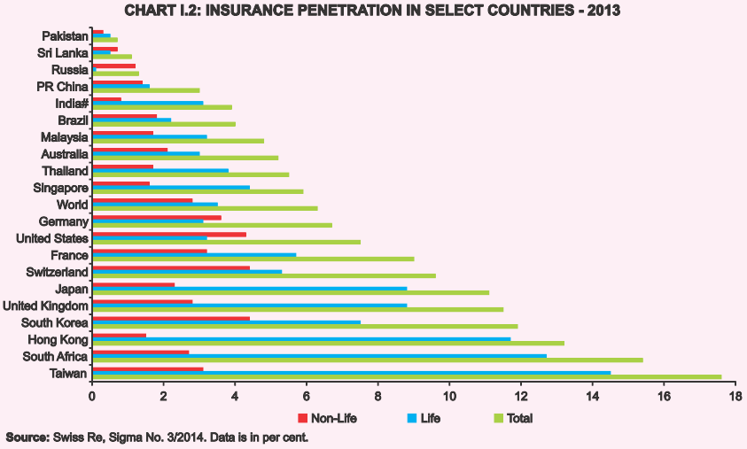
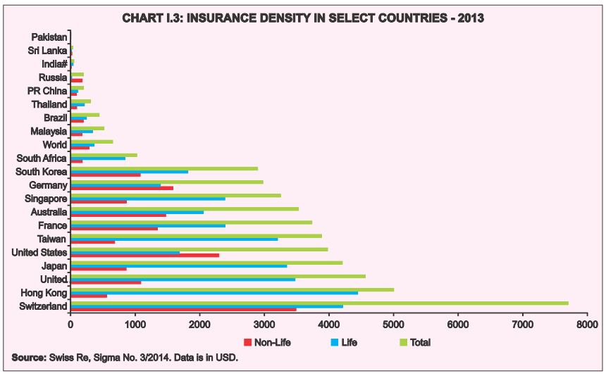
Two formulas (IRDA annual report 2013-14)
Penetration=prem/GDP
Density=prem/pop.

Slide 46
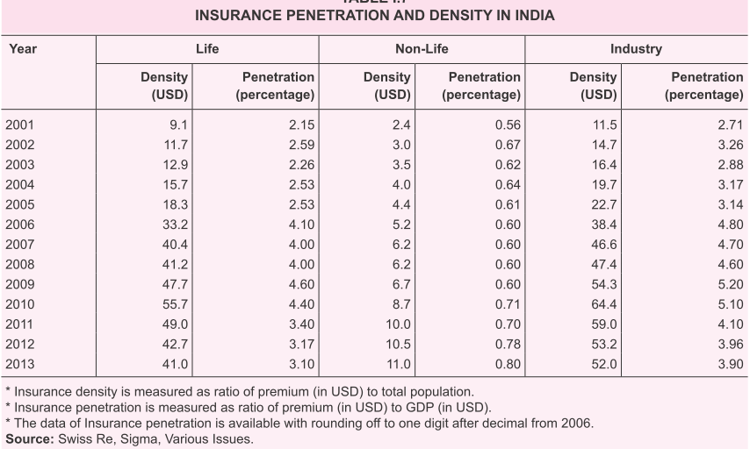
Insurance penetration and density (2013-14)

Slide 47
SS, NPS, Atal Pension
Insurance: Theory & Types
Insurance: History & Nationalization
IRDA, Powers
Public sector insurance Co.
Fin. Inclusion:
PM JJ & Surksha
Intermediaries & Ombudsman
49% FDI: Pro-Cons

Slide 48
Insurance in In the world (not for UPSC)
4500 BC
1347
1688
Babylonia Caravans
European Maritime Insurance
Llyod’s Coffee House, UK as meeting place of insurance agents
1967
Dr. Nicolas Barbon
1st Fire insurance
1756
1st life insurance co. “Old Equitable”, UK

Slide 49
Insurance: mathematical theory? (not for UPSC)
Jakob Bernoulls (1700)
Laws of Large numbers
Edmund Haley (1693)
Mortality table
Premium vs. lifespan
To predict average total loss /liability of company
Joseph Dodson updated

Slide 50

History ancient India
insurance
1000 BC: Aryans practiced “community insurance”
Joint family system itself insurance
Rigveda: “Yogakshema” (well being) – name of LIC HQ, Mumbai & corporate magazine
Gita: “योगक्षेमं वहाम्यहम्” (Yogakshemam Vahamyaham)- I ensure safety and well being (of my devotees) – LIC motto

Slide 51

Insurance = similar banking
L1P6-P8
Firangi Banks
RBI supervision
Desi Bank
Nationalization
Narsimhan new Banks
Financial inclusion? PMJDY

Slide 52
General insurance
British
1818: 1st Life insurance co. in India: Oriental Life insurance. Aim- help European widows
British insurance companies charged ~20% extra premium on Indians – saying they’re “subnormal” –more likely to die.
1870: Bombay Mutual life assurance company- first INDIAN company. No extra premium on Indian clients.

Slide 53
General Insurance
British
1850: 1st General insurance: Trinton, Calcutta
1907: Indian mercantile insurance ltd. Bombay
1919: New India Assurance- 1st fully Indian owned (general)

Slide 54
Need for supervision
British India
Rising # of companies in Swadeshi , NCM, CDM movements
1912: life insurance companies act
1938: insurance Act
Notes:
Just like American recession led to birth of RBI here too legal initivates

Slide 55
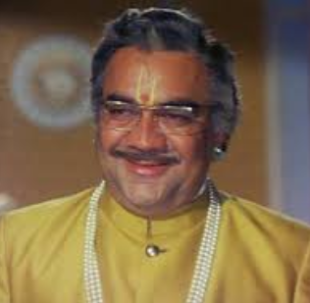

Mid-1950s: scams, impropriety, embezzlement
Indian insurers
75
154
Foreign insurers
16
Provident societies
1956: LIC took over 245 Life companies (or 243- depends)
1972: GIC took over 107 General insurance companies

Slide 56
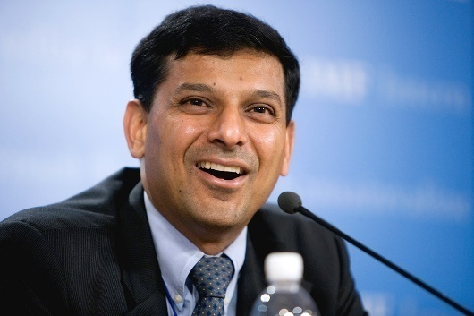
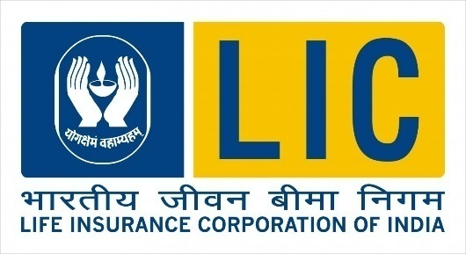
Bank nationalization
Insurance nationalization
1955: Imperial Bank-> SBI
1969: 14 banks (50 cr. Depo)
1980: 6 banks (200 cr. Depo)
More L1/P5.pptx
1956: Life insurance- LIC Act
1972-73: General Insurance- GIC Act - & its four subsidiaries- took over 107 private General insurance cos.

Slide 57
SS, NPS, Atal Pension
Insurance: Theory & Types
Insurance: History & Nationalization
IRDA, Powers
Public sector insurance Co.
Fin. Inclusion:
PM JJ & Surksha
Intermediaries & Ombudsman
49% FDI: Pro-Cons

Slide 58
Public sector insurers
Life
LIC
Non-Life
4+2
Re-insurance
GIC

Slide 59
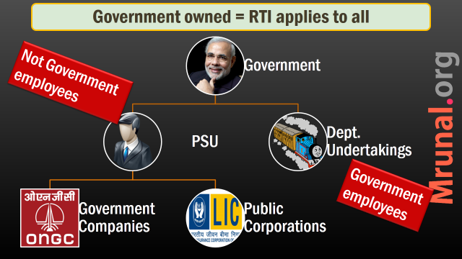

LIC
insurance
19/1/1956: nationalization of 154 desi, 16 foreign, 75 provident societies
All taken over by LIC Act
It is a “Corporation” not a company. (ref L5/P3.pptx)

Slide 60
LIC subsidiaries (may be outdated data)
LIC
Mutual fund
Pension Fund
Overseas
Nepal
LIC Intl.
Lanka

Slide 61
Public sector insurers
Life
LIC
Non-Life
4+2
Re-insurance
GIC

Slide 62
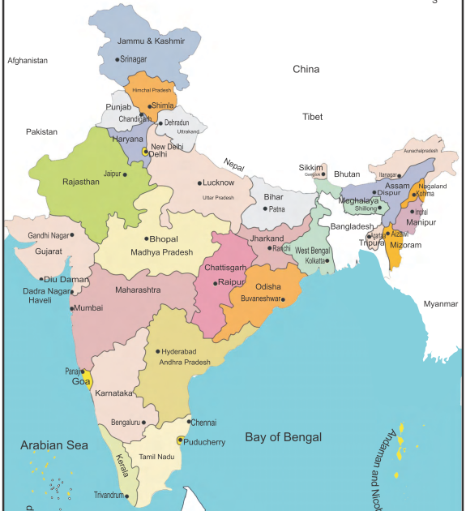
Public sector General insurance companies
Oriental (‘47)
National Insurance
New India Assurance
United India

Slide 63
(4 + 2) Public sector General insurance Co. LTD
1: National Insurance
1906, HQ: Kolkata, During Swadeshi Movement era
Strong presence in North & Eastern region
2: New India Assurance
1919, Mumbai, Sir Dorabji Tata
1st Fully Indian owned. Now 100% Govt.owned
Major player overseas market
Satellite insurance (INSAT 2E)

Slide 64
(4 + 2) Public sector General insurance Co. LTD
3: United India
1938, HQ: Chennai
Insured ONGC’s offshore assets (2015, May)
2nd Largest General insurance Co. (2013)
Tirupati, Airport-Hyderabad, Mumbai
4: Oriental
1947 – Govt. owned company, HQ Delhi
56: under LIC , 73: under GIC, 2003: independent
Insured Reliance-Jamnagar
Power, steel, chemical plants

Slide 65
1972: General insurance Nationalization Act
Government
GIC
Natl.insurance
New India assurance
United India
Oriental
Holding
Owner
Subsidiary Companies

Slide 66
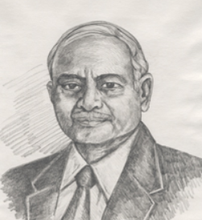
Malhotra Committee
1993-94
GIC should only look after reinsurance business.
Free GIC’s 4 subsidiaries
Bring down Government ownership from 100% to 50% in public insurance cos.

Slide 67
In 2002-03
Government 100% ownership of these companies under GI Biz. Nationalization Act 1972
Natl.insurance
New India assurance
United India
Oriental
GIC (Re-insurance)
Government
2015: They can seek addl.funding, provided that Government ownership is not diluted below 51%
Pro: addl. Funding=rural penetration

Slide 68

5th Government company
Gen. insu
Export Credit & Guarantee Corporation of India ltd (‘52) name changed in ’83
Commerce Ministry has “National Export insurance Account” (NEIA, in 2006) for projects where ECGC can’t accept clients due to business reasons.
Notes:
As per Ramesh Singh- only 4+1(agro)=5 GI
As per Bharti V. Pathak: 4+2(ECGC,agro)=6 public sector GI

Slide 69
6th Agriculture insurance Company ltd. (2002)
Notes:
Each has 8.75

Slide 70


NAIS
WBCIS
National Agri. Insurance scheme
Compulsory for farmer taking crop loans
individual approach: Factor: $$ depend on Area yield
Weather based crop insurance scheme
Voluntary
crop loss – rain, heat, cyclones
Area approach- pre-defined $$ given.

Slide 71

Peril insurance products
Crop insurance
Not compulsory
Individual farm, individual crop based
Only cover losses specified
E.g. potato insurance: “contract farmers”
Pulpwood insurance, coconut palm

Slide 72

DICGC
banking
Deposit insurance and credit guarantee corporation (DICGC)
100% RBI owned (1978)
1 of the 4 Dy.Director of RBI is chairman of this body
Link More details on function

Slide 73
General insurance business
Sarkari
national insurance
Private
Bajaj Alliance
Private cos. Cover majority of $$
new India assurance
united india
Oriental
ECGC
Agro. Insurance ltd.
ICICI Lombard
…and others
DICGC

Slide 74
Public sector insurers
Life
LIC
Non-Life
4+2
Re-insurance
GIC
Entry of Private sector?

Slide 75
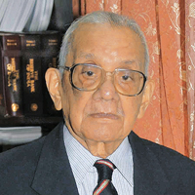
Banking
Insurance
Narsimhan-1 (1991), allow private banks
1st round: 1993 (6+4=10)
2nd round: 2001 (Yes,Kotak)
3rd: 2013 (Bandhan, IDFC)
More: L1/P6-P8.pptx
R N Malhotra- IAS, RBI Gov.
R.N. Malhotra (1993-94): allow private insurance companies
1996: IRDA setup, 1999: Act
2000: IRDA made formal regulator & private cos. Allowed.

Slide 76
Insurance companies today (click for IRDA links)
Life
General
28
List
Re-insurer
1
24
List
GIC

Slide 77
Malhotra on private insurance cos.
insurance
Private cos. With 100 cr. Capital can enter, but control # of entrants.
Same co. can’t run both life and general insurance.
Foreigner through branches…no
Only by JV with Indian cos.
Upgrade public insurance co. technology to compete with private

Slide 78
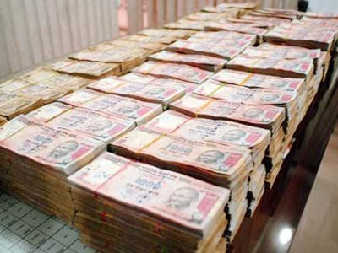
Paid up capital= supplied by shareholders
Min. paidup
Company | Rs.
Life insurance | 100 cr.
General insurance | 100 cr.
Health insurance | 100 cr.
Re-insurer | 200 cr.
Foreign re-insurer opening branch in India | 5000 cr.

Slide 79
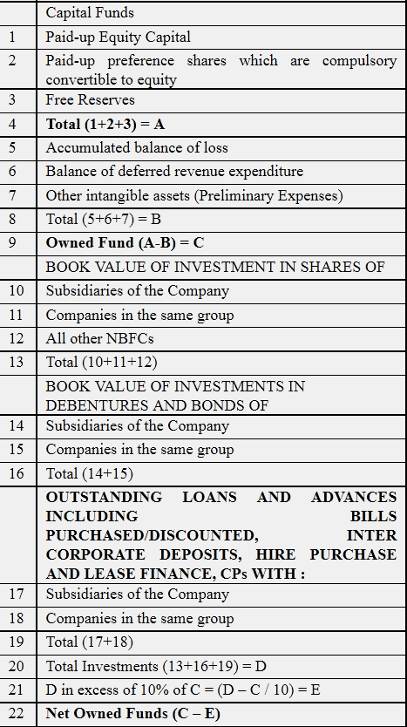
company
Amendment
Net owned funds: Rs.500 crores
Register as public ltd. Company (L2P4.pptx)
26% 49% shareholding by foreign investors (FDI + FII)
Indian owned, Indian controlled= control over directors' appointment, management and policy decisions.

Slide 80
Benefits/Criticism of Insurance Amendment
Accountability
Will improve
BoP / infra. Investment
Will not improve
Will improve
Will not
Rural penetration
Will Happen
Will not Happen

Slide 81
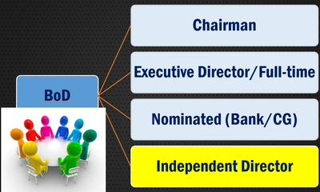
How public ltd. Improve accountability
Amendment
Bajaj Allianz, ICICI Prudential, Reliance Life Insurance, and SBI Life Insurance planning to launch IPO- to attract both FDI, FII
When they become public listed companies- fall under Companies Act 2013
Norms for independent directors, women directors, whistleblower protection, salary-threshold, audit-accounts, CSR become more transparent. (L2P4.pptx)

Slide 82
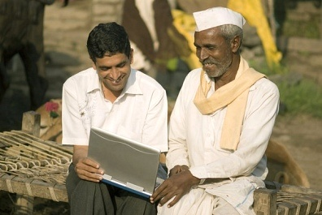
No expansion = No penetration
amendment
FII investment easy, if company listed on stock exchange.
But not all insurance companies profitable / mature enough to comeup with IPO. (counter: merge with big players)
Indian partners will liquidate their stakes , no fresh investment will come in. SBI just wants to sell its shareholding to foreign partners.

Slide 83
OptA: IAG supply new capital (good) | OptB: IAG buy SBI’s shares (no new capital)
SBI General
SBI General
SBI (51%)
Insurance Australia Group (IAG): 49%
SBI (74%)
Insurance Australia Group (IAG): 26%

Slide 84

Will increase tax AVOIDANCE
amendment
Indian arm (74%) => sell their shares to foreigners => 51% | 49%
If top five players do this- 20k crore capital gains tax.
But what if Vodafone all over again- selling of assets using post box companies in tax havens? L2P3.pptx
Counter: budget 2015 clarified the norms when IT can intervene L4P2.pptx

Slide 85

Accountability criticism
Amendment
Foreign participants have their own norms in parent country -subsequently may lobby in India to relax its norms, loopholes in taxation / capital gains / royalties.
Even with Indian control over insurance company, but still foreign participants will influence Decision Making- sometimes not in best interest of India.

Slide 86
Accountability criticism
Amendment
May use clients' money for speculative trading, investment in junk bonds to offer higher return => overleveraged companies =>Collapse of asset bubble/NPA
Counter: “investment pattern”; IRDA-investigate, SAT appellate
Trade Union: Profit/target minded MNCs will not entertain employee unions' demands. “target driven private companies” / Whistleblower=> Job Loss

Slide 87
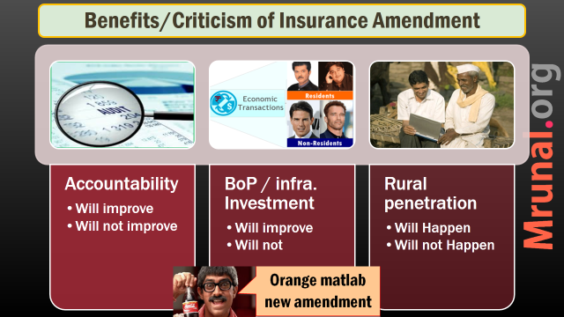
Public sector insurers
Life
LIC
Non-Life
4+2
Re-insurance
GIC
Entry of Private sector?

Slide 88
Reinsurance (पुनर्बीमा)

Slide 89

WHY?
Re-insurance
1835: Great NewYork fire
1871: Great Chicago fire
1966: great fire in London
Re-insurance needed to stabilize peak profit and peak loss
“spread out the risk”
Protect against unpredictable events such as airline crash, large scale damages
Notes:
An umbrella protecting another umbrellas.

Slide 90

WHO?
Re-insurance
As such LIC capable of sustaining the losses
But IRDA norms Reinsurance mandatory for both life and General
Under insurance Act, only 1 re-insurance “GIC”
1972: General insurance nationalized
2000: GIC becomes India’s only re-insurer
2002: 4 subsidiaries became directly owned by Government.

Slide 91
GIC
Re-insurance
GIC insures Air India, HAL, AAI directly
Manages third party motor pool
Invests money in G-sec, UTI, securities of private and public cos.

Slide 92
WHAT?
Re-insurance
Indian cos. Need to take 20% re-insurance from it.
Remaining portion- free to pick re-insurance cos. abroad- @Munich Re, Swiss Re etc. (but, need atleast BBB rating by S&P)
GIC has sufficient funds to cater only 40% of Indian requirement
Rest met by Indian insurance cos. Going abroad for re-insurance
Foreign re-insurance cos. Not coming to India for FDI limits.

Slide 93

Entry of foreign RE.
Amendment
Amendment permits foreign re-insurance companies to
open branches in India (min. 5k crore paidup capital of parent company)
Or invest in other Indian Re. company, upto 49%
Re-insurance defined as “part of risk transferred to another insurer”- else weak companies would act as ‘front’ for others without due Diligence.

Slide 94
SS, NPS, Atal Pension
Insurance: Theory & Types
Insurance: History & Nationalization
IRDA, Powers
Public sector insurance Co.
Fin. Inclusion:
PM JJ & Surksha
Intermediaries & Ombudsman
49% FDI: Pro-Cons

